Slide 1


Slide 2
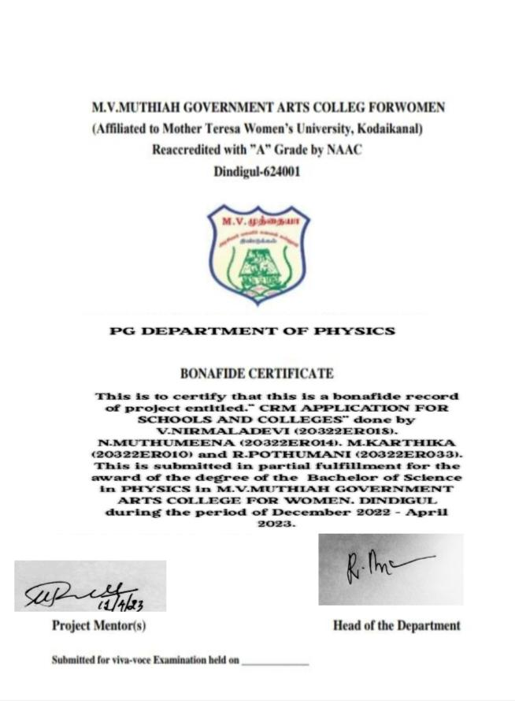

Slide 3
CRM APPLICATION FOR SCHOOLS AND COLLEGES
Creation of an application for schools and colleges

Slide 4
CRM APPLICATION FOR SCHOOLS AND COLLEGES
Submitted by
V.NIRMALADEVI (20322ER018)
M.KARTHIKA(20322ER010)
N.MUTHUMEENA(20322ER014)
R.POTHUMANI(20322ER03)
TEAM ID: NM2023TMIDO7447
Under the guidance of
Dr.M.RAMESH M.Sc.,M.Phil.,Ph.D.,
Assistant Professor
PG DEPARTMENT OF PHYSICS
M.V.MUTHIAH GOVERNMENT ARTS COLLEGE FOR WOMEN
DINDIGUL -624001.

Slide 5
INTRODUCTION:
Salesforce is a cloud-based software company that provides its customers with a platform to develop their own applications without following the tough steps that they used to follow in the legacy system. The software or application once created can be uploaded onto the cloud allowing the end-users to view them.
1.1 OVERVIEW :
This Project helps you to maintain and manage the school related problems which further can be modified based on the requirements.
1.2 PURPOSE :
The project aim is to provide real-time knowledge for all the students who have basic knowledge of Salesforce and Looking for a real-time project. This project will also help those professionals who are in cross technology and want to switch to Salesforce. With the help of this project they will gain knowledge and can include it into their resume as well.

Slide 6
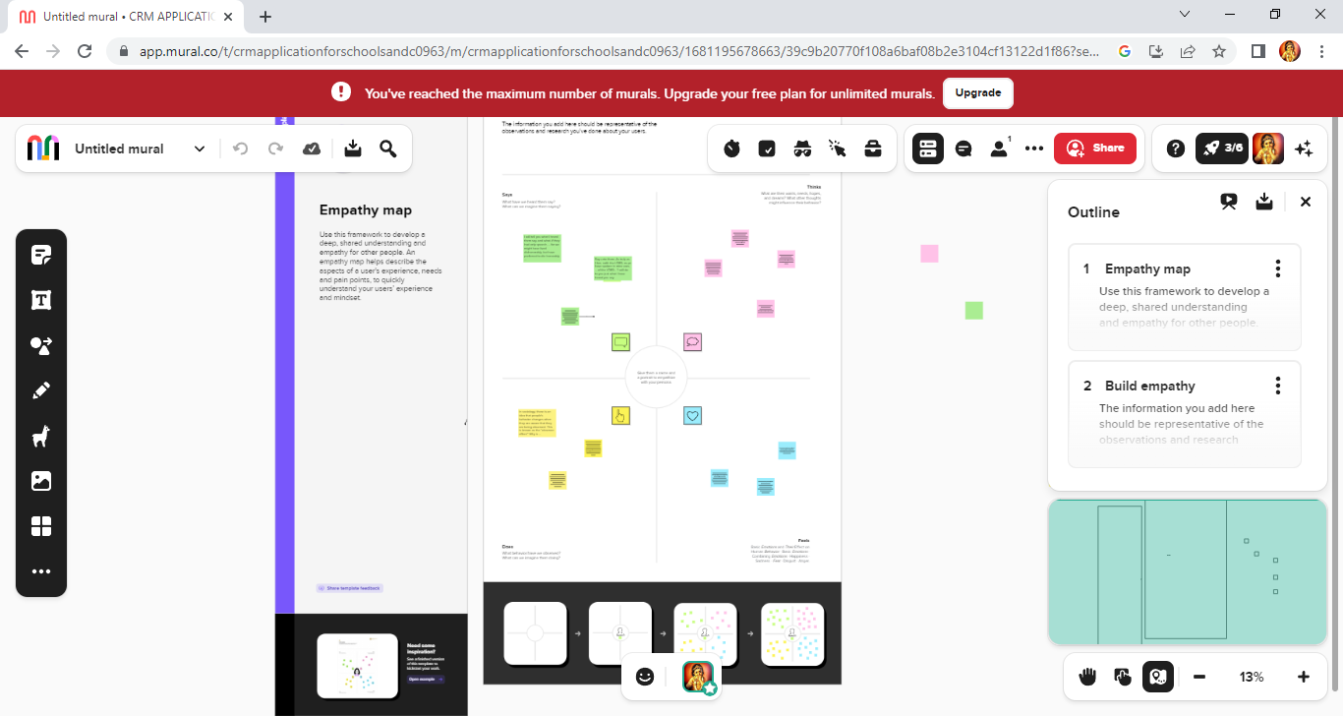
2. PROBLEM DEFINITION & DESIGN THINKING
2.1 EMPATHY MAP:

Slide 7
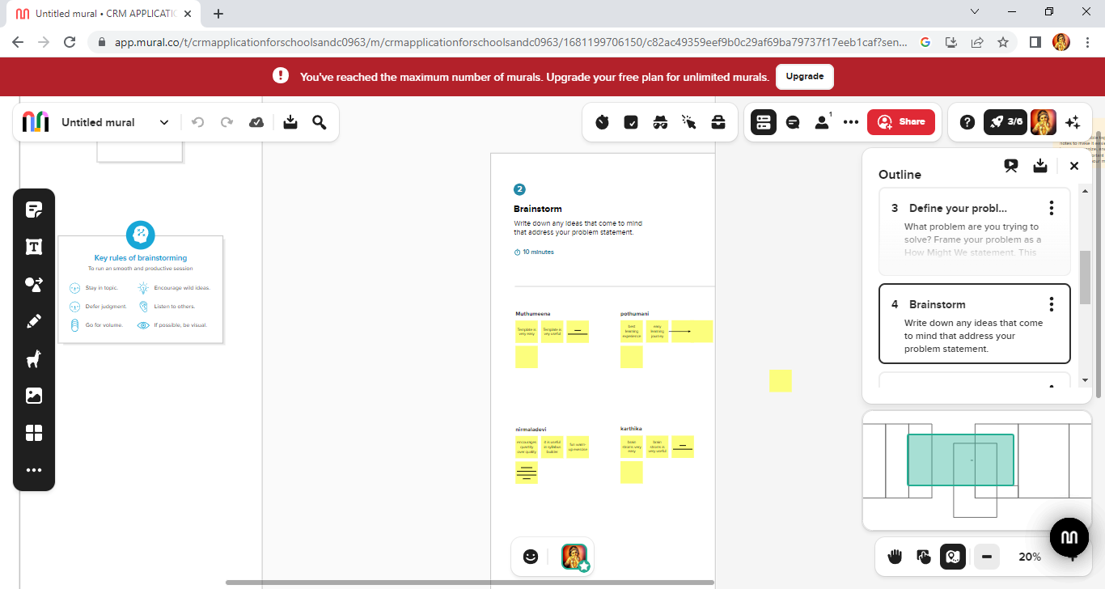

Slide 8
3.2 ACTIVITY AND SCREENSHOT
Milestone-1:
Activity : Creating Developer Account
Creating Developer Account
Creating a developer org in Salesforce.
1. Go to http://developer.salesforce.com/
2. Click on sign up.
3. On the sign up form, enter the following details :
a. First name & Last name
b. Email
c. Role : Developer
d. Company : College Name
e. County : India
f. Postal Code : pin code
g. Username : should be a combination of your name and company This need not be an actual email id, you can give anything in the format : username@organization.com

Slide 9
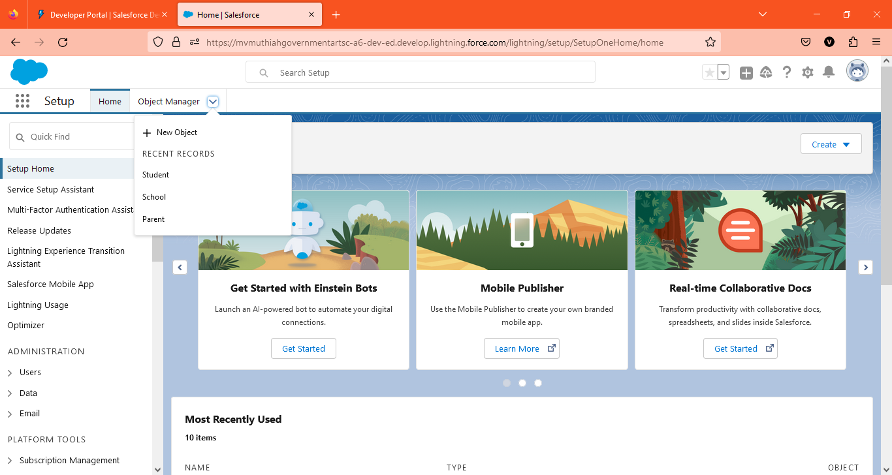
Login To Your Salesforce Account
1. Go to salesforce.com and click on login.
2. Enter the username and password that you just created.
3. After login this is the home page which you will see.

Slide 10
Milestone-2: OBJECT
ACTIVITY -1: Creation of School Object
1. Click on the gear icon and then the select setup.
2. Click on the object manager tab just beside the home tab .
3. After the above steps, have a look on the extreme right you will find a Create Dropdown click on that and select Custom object.
On the Custom object definition page , create the object as follows:
Label: school
Plural label: schools
Record name: school name
Check the Allow Reports check box
Check the Allow Search check box
Click save.

Slide 11
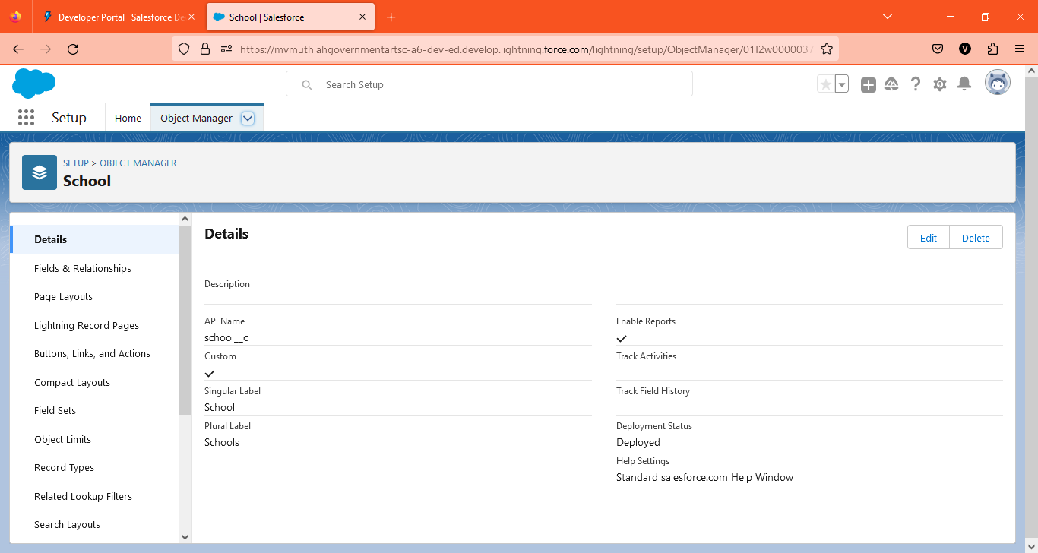

Slide 12
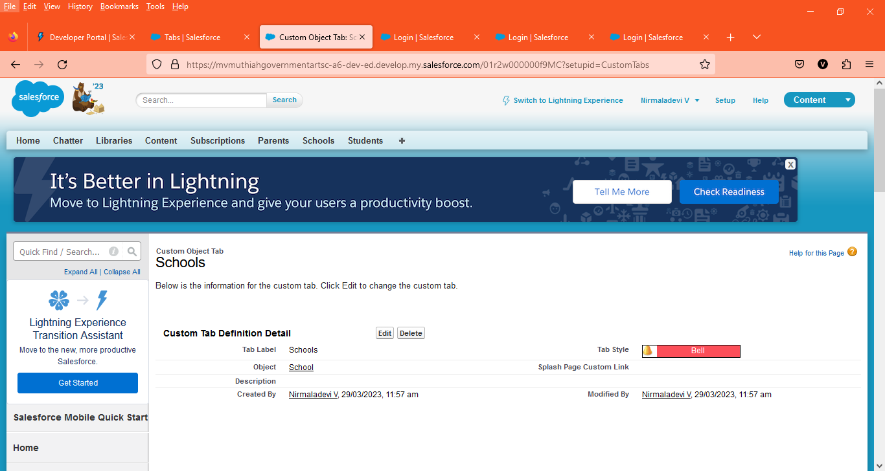
Now create a custom tab. Click the Home tab, enter Tabs in Quick Find and select Tabs. Under Custom Object Tabs, click New.
1. For Object, select School.
2. For Tab Style, select any icon.
3. Leave all defaults as is. Click Next, Next, and Save.

Slide 13
In the same way create other objects such as students and parents.
Activity 2: Create student object
1. Click on the gear icon and then select Setup.
2. Click on the object manager tab just beside the home tab.
3. After the above steps, have a look on the extreme right you will find a Create Dropdown click on that and select Custom Object.
On the Custom Object Definition page, create the object as follows:
Label: Students
Plural Label: Students
Record Name: Student Name
Check the Allow Reports checkbox
Check the Allow Search checkbox
Click save.

Slide 14


Slide 15
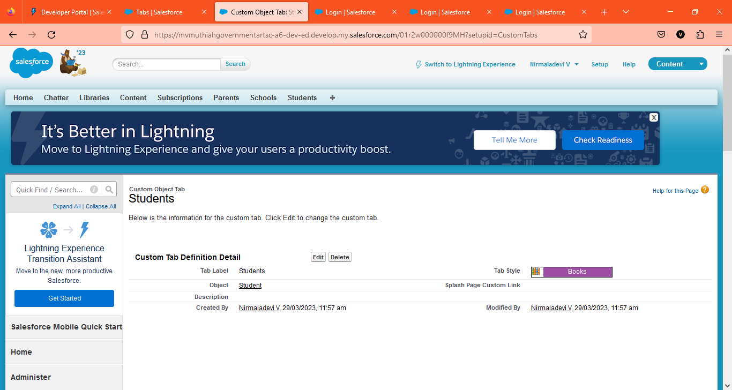
Now create a custom tab. Click the Home tab, enter Tabs in Quick Find and select Tabs. Under Custom Object Tabs, click New.
1. For Object, select Students.
2. For Tab Style, select any icon.
3. Leave all defaults as is. Click Next, Next, and Save.

Slide 16
Activity 3: Create parent object
1. Click on the gear icon and then select Setup.
2. Click on the object manager tab just beside the home tab.
3. After the above steps, have a look on the extreme right you will find a Create Dropdown click on that and select Custom Object.
On the Custom Object Definition page, create the object as follows:
Label: Parent
Plural Label: Parents
Record Name: Parent Name
Check the Allow Reports checkbox
Check the Allow Search checkbox
Click Save.

Slide 17

Now create a custom tab. Click the Home tab, enter Tabs in Quick Find and select Tabs. Under Custom Object Tabs, click New.
1. For Object, select Parents.
2. For Tab Style, select any icon.
3. Leave all defaults as is. Click Next, Next, and Save.

Slide 18
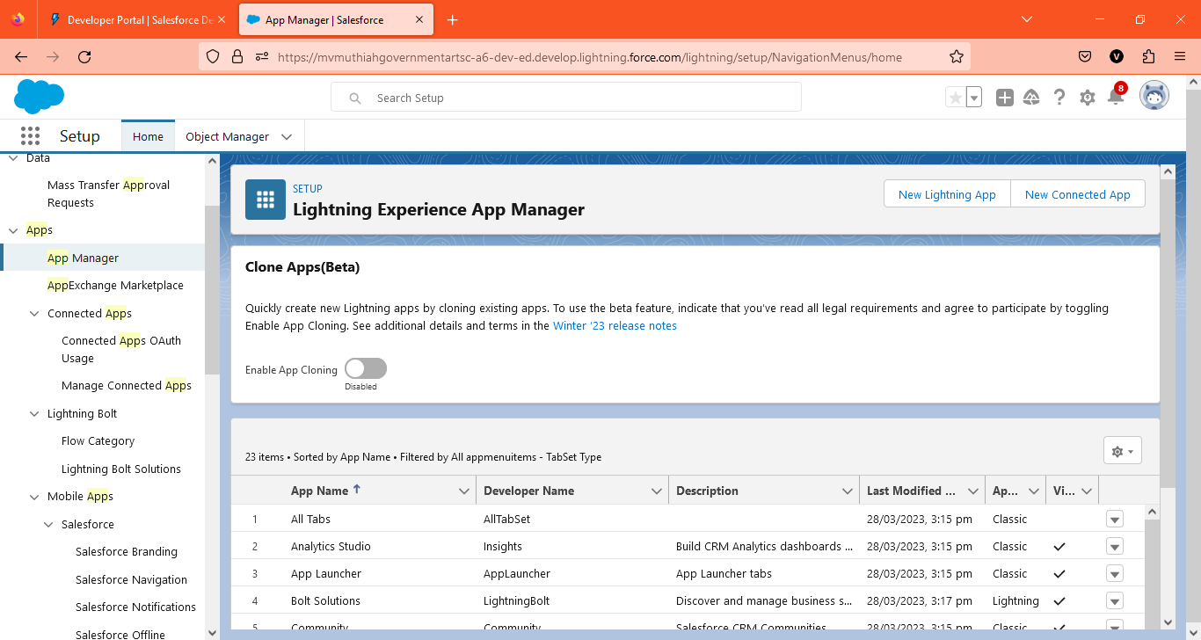
Milestone-3: Lightning App
Apps in Salesforce are a group of tabs that help the application function by working together as a unit. It has a name, a logo, and a particular set of tabs. The simplest app usually has just two tabs
Activity : Create the School Management app
● From Setup, enter App Manager in the Quick Find and select App Manager.

Slide 19
● Click New Lightning App. Enter School Management as the App Name, then click Next
● Under App Options, leave the default selections and click Next.
● Under Utility Items, leave as is and click Next.
● From Available Items, select Schools ,Students ,Parents, Reports, and Dashboards and move them to Selected Items. Click Next.
● From Available Profiles, select System Administrator and move it to Selected Profiles. Click Save & Finish.
● To verify your changes, click the App Launcher, type School Management and select the School Management app.

Slide 20
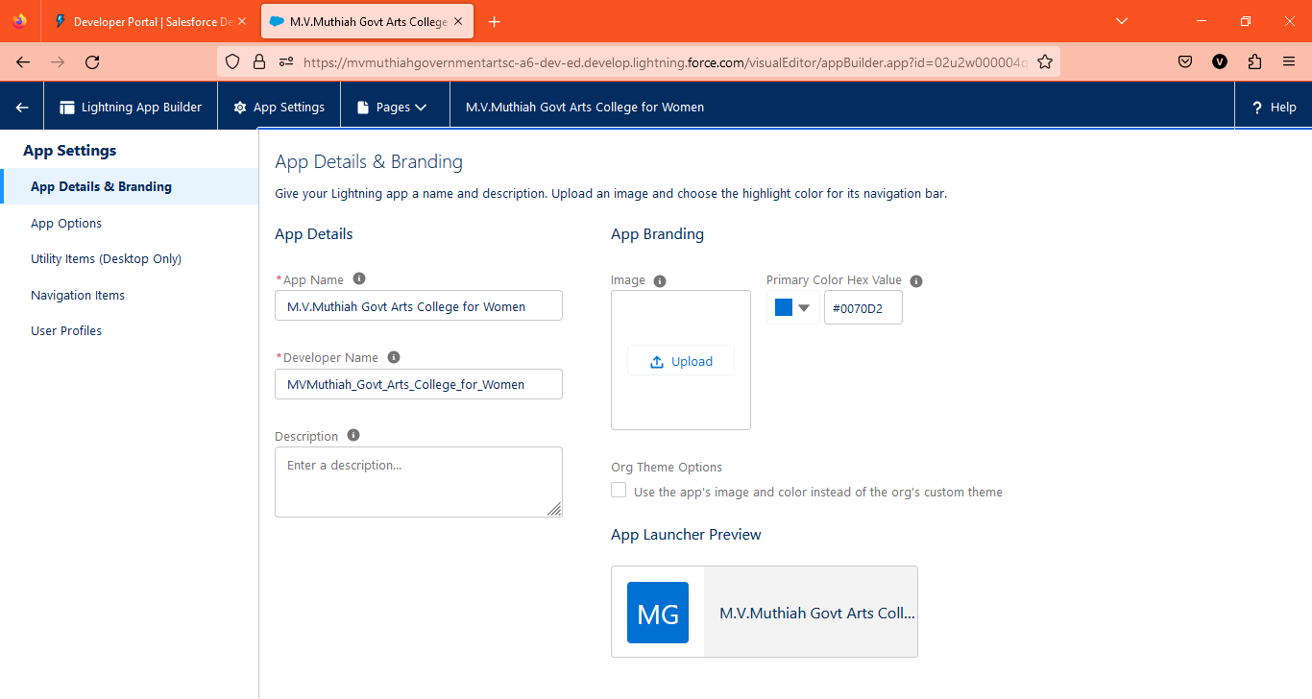

Slide 21
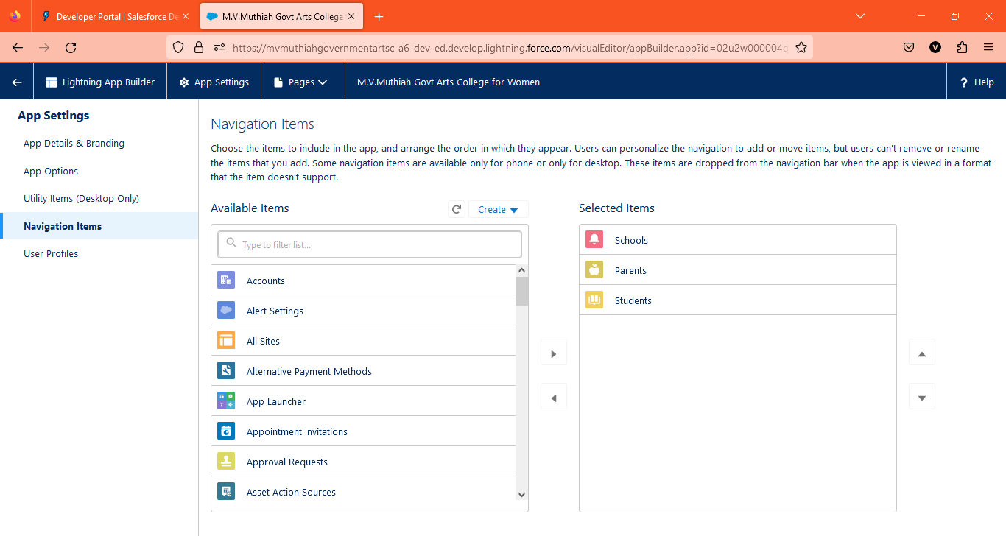

Slide 22
Milestone -4: Fields and Relationship
An object relationship in Salesforce is a two-way association between two objects. Relationships are created by creating custom relationship fields on an object. This is done so that when users view records, they can also see and access related data.
Activity-1: Creation of fields for the School objects:
1. click the gear icon and select Setup. This launches Setup in a new tab.
2. Click the Object Manager tab next to Home.
3. Select School.
4. Select Fields & Relationships from the left navigation, and click New

Slide 23
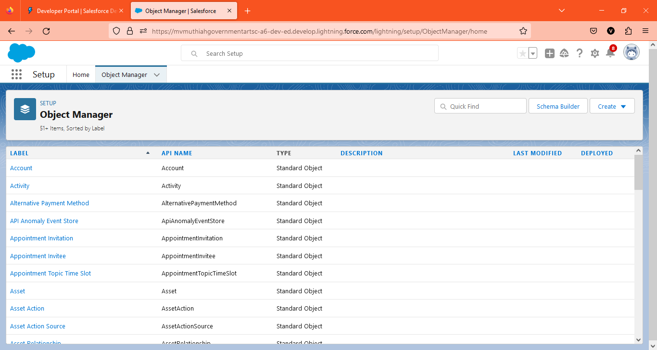

Slide 24
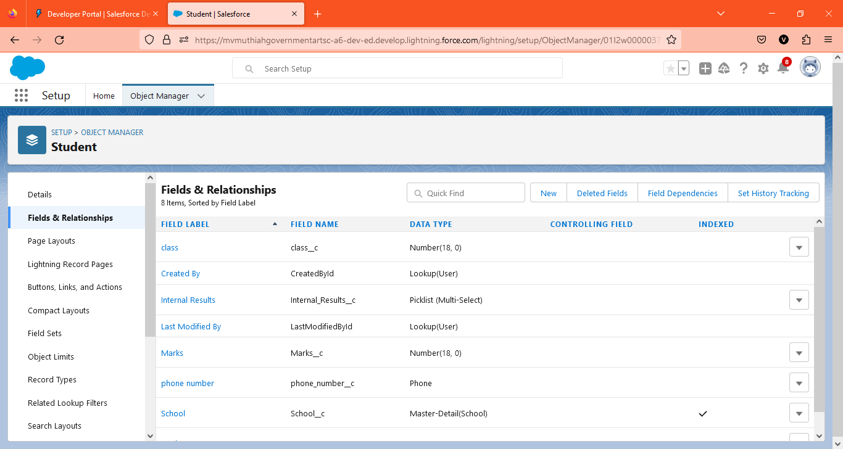

Slide 25
Now we're ready to make a custom field. Let's do this!
1. Select the Text Area as the Data Type, then click Next.
2. For Field Label, enter Address.
3. Click Next, Next, then Save & New.
4. Follow steps 1 through 3 and create two more text areas with District , State and School websites as the field labels.

Slide 26
Now let's create the other fields and we must choose the data types of the fields carefully .Let's have a look at it.
For example, a phone number is a number field. For that we need to select the phone as data type .
Lets see this
1. Select the Phone as the Data Type, then click Next.
2. For Field Label, enter Phone Number.
3. Click Next, Next, then Save & New.
Lets create Roll-up summary fields to calculate the number of students
1. From Setup, click Object Manager and select School.
2. Click Fields & Relationships, then New.
3. Select the Roll-up summary field as data type
4. Enter the field label as Number of students
5. Click Next
6. Then select the master object summarized as students and then select count as roll-up and then click Next , Next and save.

Slide 27
1. From Setup, click Object Manager and select School.
2. Click Fields & Relationships, then New.
3. Select the Roll-up summary field as data type
4. Enter the field label as Highest Marks
5. Click Next
6. Then select the master object summarized as students and then select Max as roll-up and then select Marks as field to aggregate .click Next ,Next and save.
Activity-2: Creation of fields for the Student objects:
1. Select the Phone as the Data Type, then click Next.
2. For Field Label, enter Phone Number.
3. Click Next, Next, then Save & New
Let's create a master-detail relationship with school object
1. Select Master-Detail Relationship as the Data Type and click Next.
2. For Related to, enter School.
3. Click Next.
4. For Field Label, enter School.
5. Click Next, Next, Next and Save.

Slide 28
Lets create a Pick-List field:
1. From Setup, click Object Manager and select Student.
2. Click Fields & Relationships, then New.
3. Select Pick-list as the Data Type and click Next.
4. For Field Label enter Results.
5. Select Enter values, with each value separated by a new line and enter these values:
6. Pass
7. Fail
8. Click Next, Next, then Save & New
Lets create a Number field:
1. Select the Number as the Data Type, then click Next.
2. For Field Label, enter Class.
3. Click Next, Next, then Save & New
4. Follow steps 1 through 3 and create one more number field with Marks as the field labels.

Slide 29
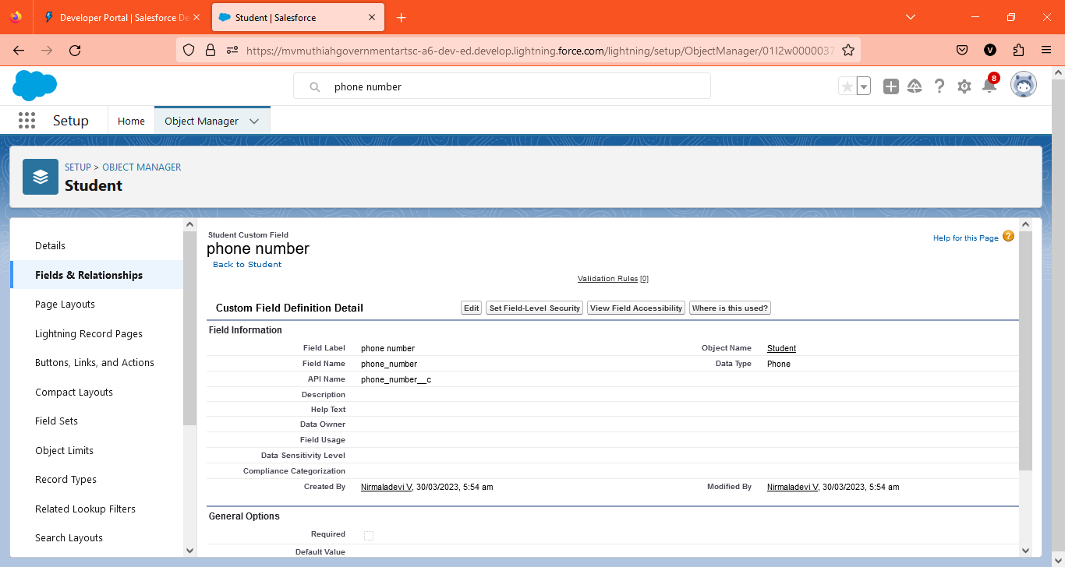

Slide 30

Activity-3: Creation of fields for the Parent objects:
1. Select the Text Area as the Data Type, then click Next.
2. For Field Label, enter Parent Address.
3. Click Next, Next, then Save & New.
4. Select the Phone as the Data Type, then click Next.
5. For Field Label, enter Parent Number.
6. Click Next, Next, then Save & New

Slide 31
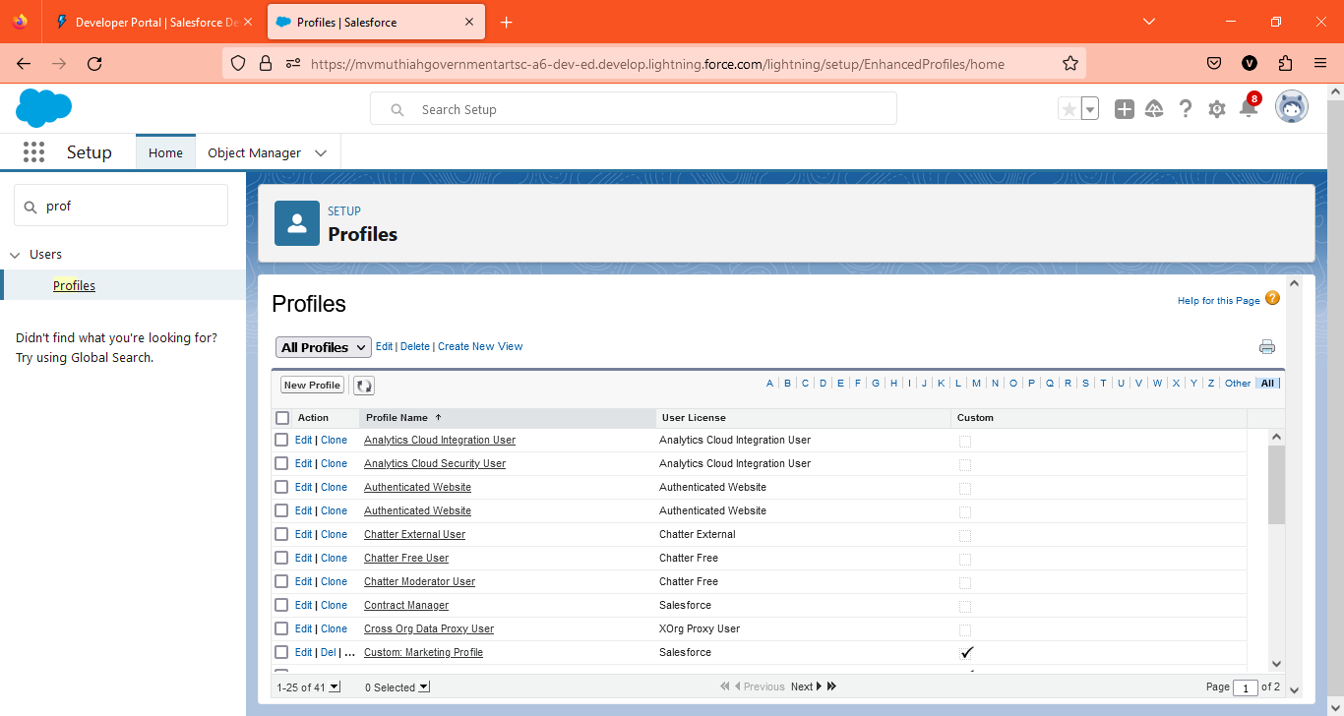
Milestone-5: Profile
A profile is a group/collection of settings and permissions that define what a user can do in Salesforce . A profile controls “Object permissions, Field permissions, User permissions, Tab settings, App settings, Apex class access, Visual force page access, Page layouts, Record Types, Login hours & Login IP ranges
Activity : Creation on profile:
From Setup enter Profiles in the Quick Find box, and select Profiles.
1. From the list of profiles, find Standard User.
2. Click Clone.

Slide 32
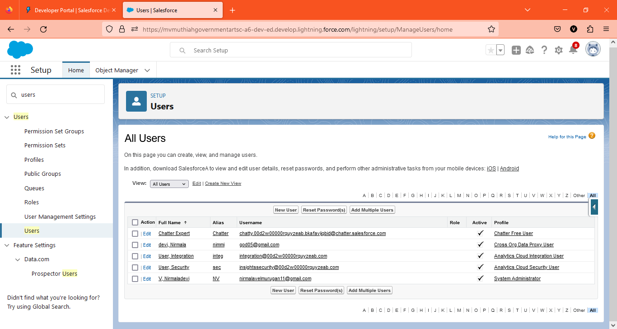
Milestone-6: Users
A user is anyone who logs in to Salesforce. Users are employees at your company, such as sales reps, managers, and IT specialists, who need access to the company's records. Every user in Salesforce has a user account.
Activity : Creating a Users:
1. From Setup, in the Quick Find box, enter Users, and then select Users.
2. Click New User.

Slide 33
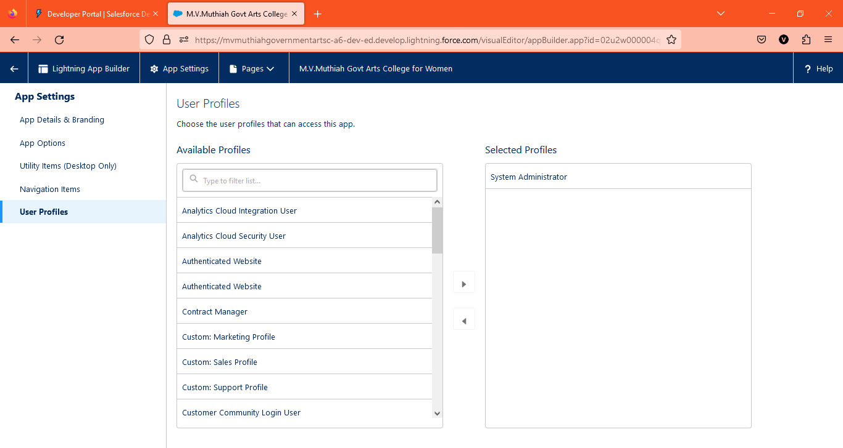
3. Enter the user’s name Parents and (Your) email address and a unique username in the form of an email address. By default, the username is the same as the email address.
4. Select a User License As Salesforce .
5. Select a profile as a School profile.
6. Check Generate new password and notify the user immediately to have the user’s login name and a temporary password emailed to your email.

Slide 34
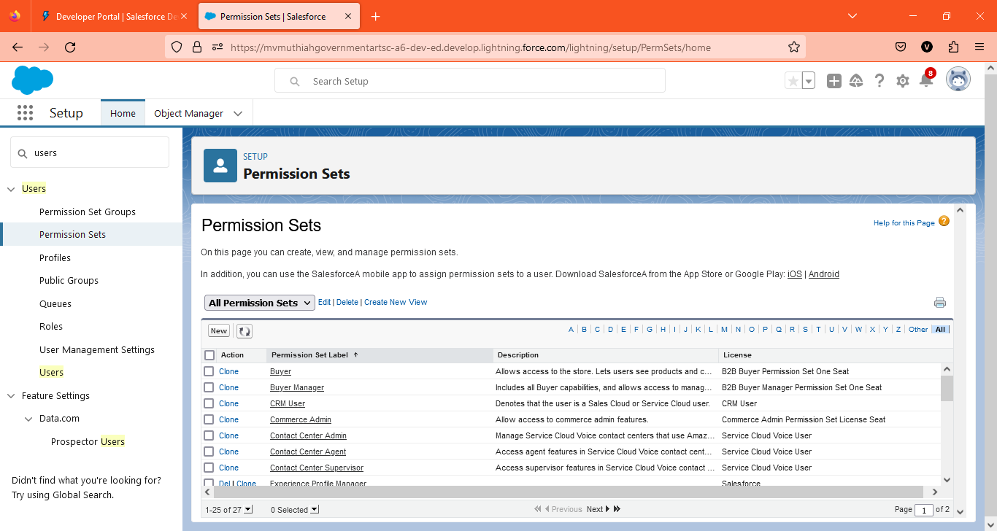
Milestone-7: Permission sets
A permission set is a collection of settings and permissions that give users access to various tools and functions. Permission sets extend users' functional access without changing their profiles.
Activity-1:
Permission sets 1:
1. From Setup, enter Permission Sets in the Quick Find box, then select Permission Sets.
2. Click New.

Slide 35
Similarly follow the above steps for the permission set 2.
Activity-2:
Permission sets 2:
1. From Setup, enter Permission Sets in the Quick Find box, then select Permission Sets.
2. Click New.
3. Give the name of the Permission set name as Principal permission and then under the object settings give all permissions for the custom objects and assign them to the Principal user.

Slide 36
Milestone-8: Reports
A report is a list of records that meet the criteria you define. It's displayed in Salesforce in rows and columns, and can be filtered, grouped, or displayed in a graphical chart. Every report is stored in a folder. Folders can be public, hidden, or shared, and can be set to read-only or read/write.
Activity : Reports :
1. From the Reports tab, click New Report.

Slide 37
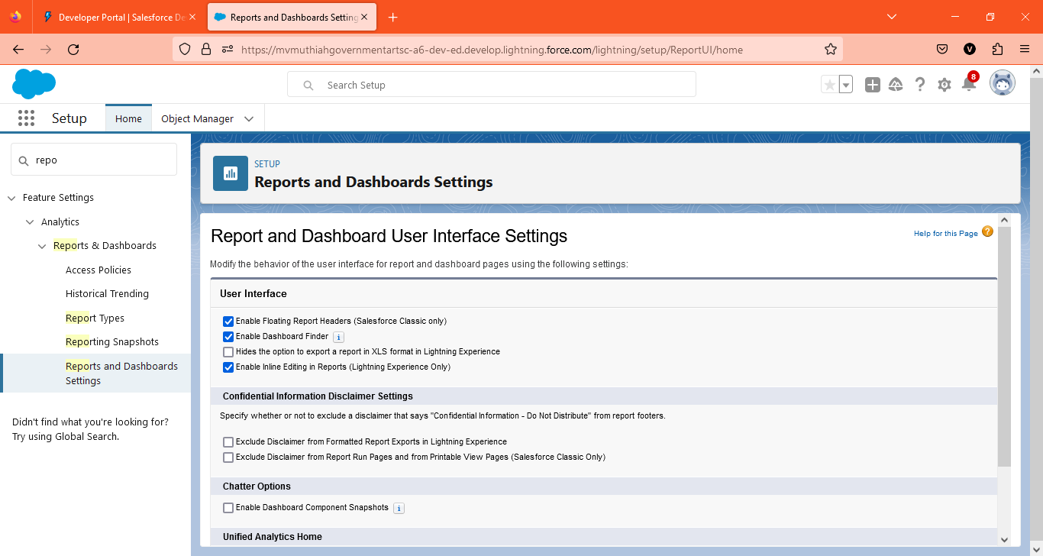
2. Select the report type as School with students and parents for the report, and click Create.

Slide 38
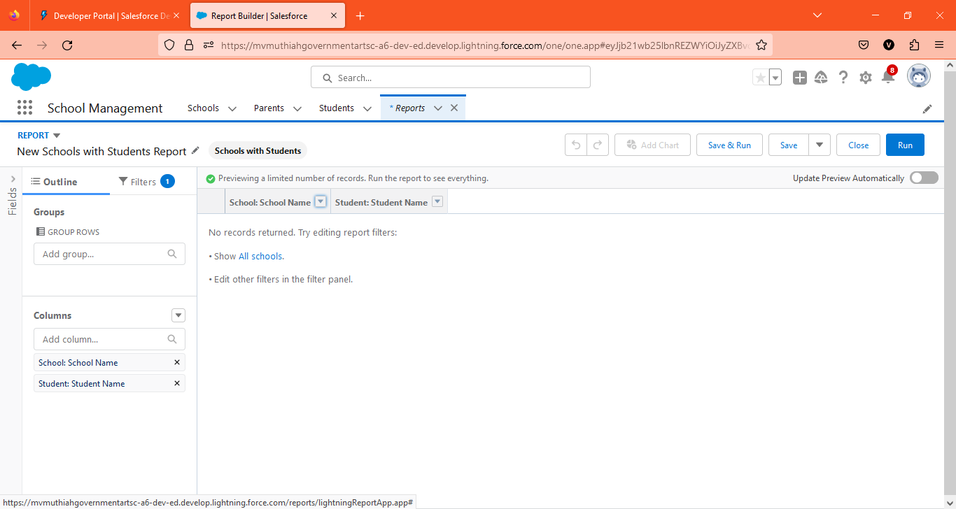
3. Customize your report, then save or run it.

Slide 39
Salesforce helps businesses keep track of customer interactions and sales data. It can manage leads, contacts, opportunities, and cases. Salesforce also offers several features to help businesses automate their sales and marketing processes, such as email marketing, lead capture, and lead scoring.
Conclusion:

Slide 40
Salesforce is a web-based CRM application that enables users to forecast revenues and track leads. It is a leading sales, service, and marketing app. Salesforce.com's Sales (CRM), Service, Platform and Marketing applications are designed to help companies connect with customers

Slide 41
Thank you!

